Slide 1


Slide 2

Event Information
Wednesday, 30 September .
9:00 AM -5:00 PM ET
Review the schedule to confirm your session’s start time. Please note that times are listed in ET.
Speakers and panelists will be asked to join the meeting 15 minutes before their session starts.
Location: Zoom events. The IOA office will provide speakers with the Zoom link via a calendar invitation.

Slide 3

Presenting From Home
What to Wear:
Solid Colors
Jewel Tones
Nice Jacket
What NOT to Wear:
Black or gray
Stripes
Patterns
T-shirts
Audio
Mute anything in your office that might beep or buzz to avoid distracting yourself and/or your audience
Avoid sound feedback by wearing a headset and updating your computer audio settings to be input and output through the headset and its microphone
If you are sharing content with audio, please make sure closed captions are enabled.
Video
Adjust your laptop or webcam so your head and shoulders take up the majority of the frame. If you need to, put your computer on a taller surface or close the lid of your laptop just enough so your head touches to top of the frame.
Look straight ahead or up into the camera for the most flattering angles.
Check the location of your computer during the time of day your presentation will take place. Make sure the lighting is sufficient. Avoid having a window behind you.

Slide 4
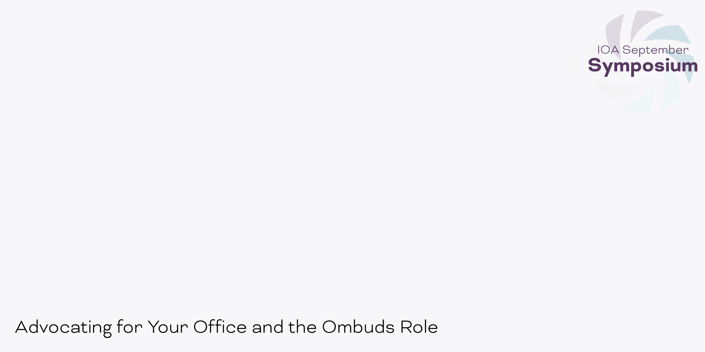
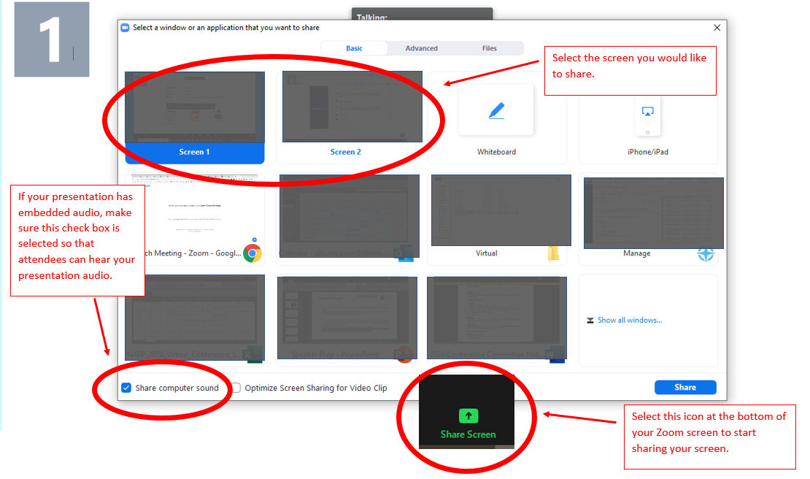
Sharing your Screen

Slide 5
Zoom Questions
Do I need Zoom to participate in the virtual event?
We recommend that you download Zoom Client for Meetings ahead of time: https://zoom.us/download
The web browser client will download automatically when you start or join your first Zoom meeting, but we recommend that you manually download it prior to the conference using the link above.
Although you do not need to download the Zoom application to participate—you can run the meeting in your browser by clicking “join from your browser” at the bottom of the page—the viewing experience is better through the app.
Look here for more information on Zoom.

Slide 6

Contact Information
Please reach out to the IOA Office to connect with a member of the team.
E: info@ombudsassociation.org| use the subject line “September Symposium Question”.
P: (206) 209-5275
Hours of support: 8:00 AM – 3:45 PM PT

